Slide 1
CrowdSenseNet
System Modelling and Design
Design and Implementation of a Crowdsensed Drive
Test Mobile App for Coverage Prediction
CEF 440 – Internet & Mobile Programming | University of Buea | Group 13 |

Slide 2
Project Overview
The Problem
The Solution: CrowdSenseNet
Mobile users in Cameroon face daily issues:
• Weak signals & call drops
• Slow internet & coverage gaps
• Rural areas left unmapped
Traditional drive testing is slow, costly, and covers only roads engineers physically travel.
Turns Android smartphones into passive signal measurement devices.
Key design priorities:
🔒 Full data anonymisation (UUID-based)
🔋 Adaptive sampling (<5% battery/hour)
📡 GPS accuracy filtering (15m threshold)

Slide 3
Modelling Methodology
Context Diagram
Data Flow Diagram
Use Case Diagram
Structural
Structural
Behavioural
Defines system boundary & external actors
Maps data movement through internal processes
Captures functional actor-system interactions
Sequence Diagram
Class Diagram
Deployment Diagram
Behavioural
Structural
Structural
Time-ordered message flow for core scenario
Static MVVM architecture of the Android app
Software components across physical nodes
Tool used: draw.io and EdrawMax | Approach: Top-down iterative
Context → Class → Deployment

Slide 4
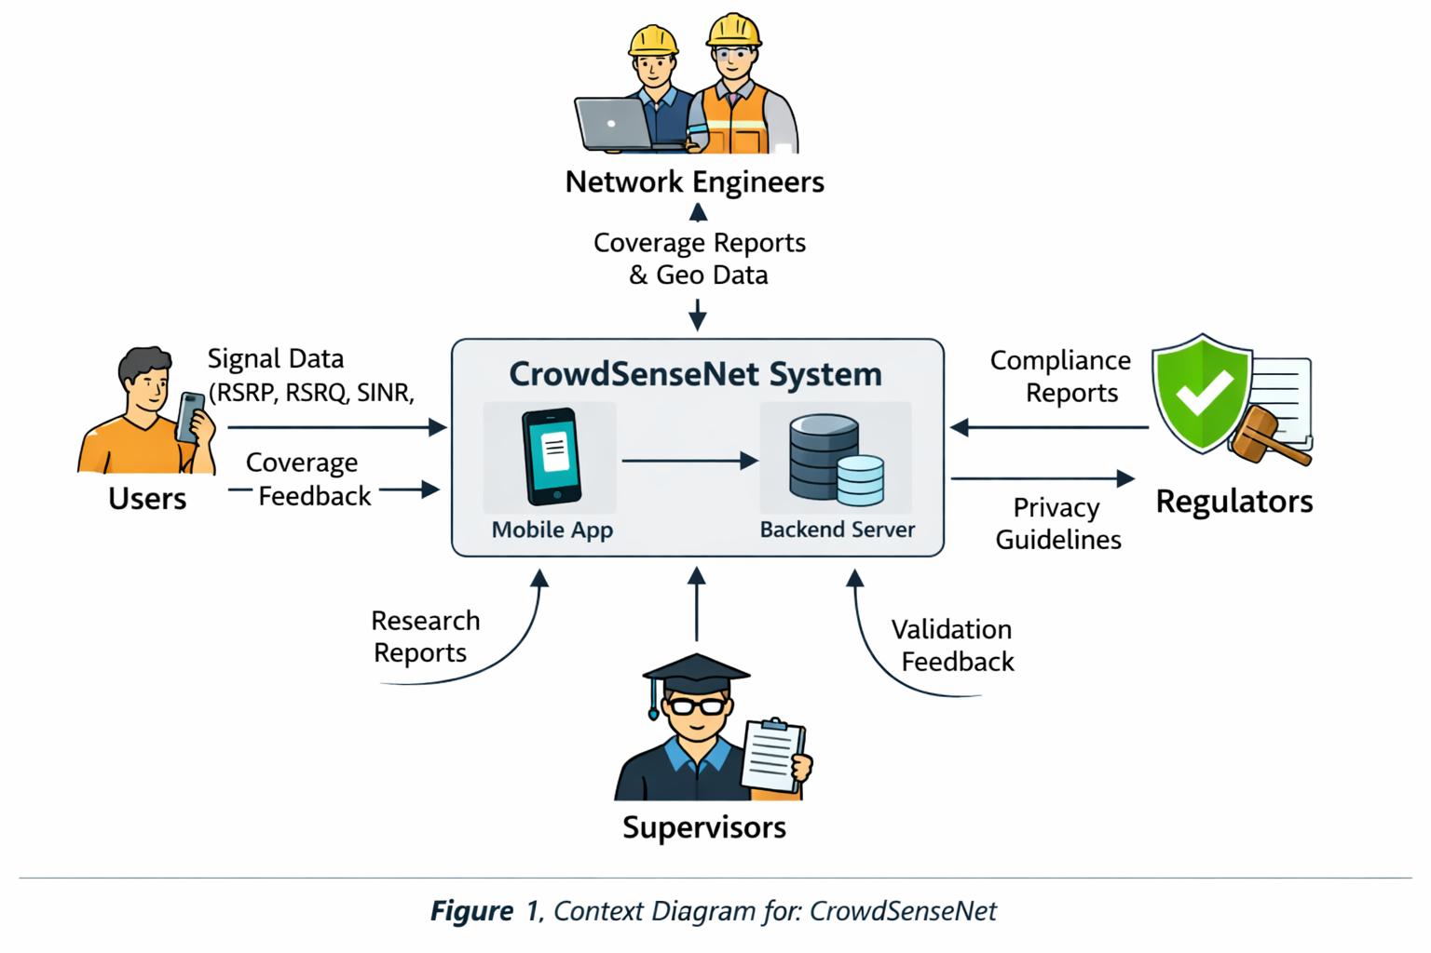
Context Diagram
Users
Network Engineers
Sends:
Sends:
Signal readings, consent, toggle
Map & export requests
Receives:
Receives:
Coverage feedback, upload status
Heatmaps, GeoJSON/CSV exports
Regulators
Supervisors
Sends:
Sends:
Privacy guidelines
Validation feedback
Receives:
Receives:
Anonymisation compliance reports
Project documentation

Slide 5
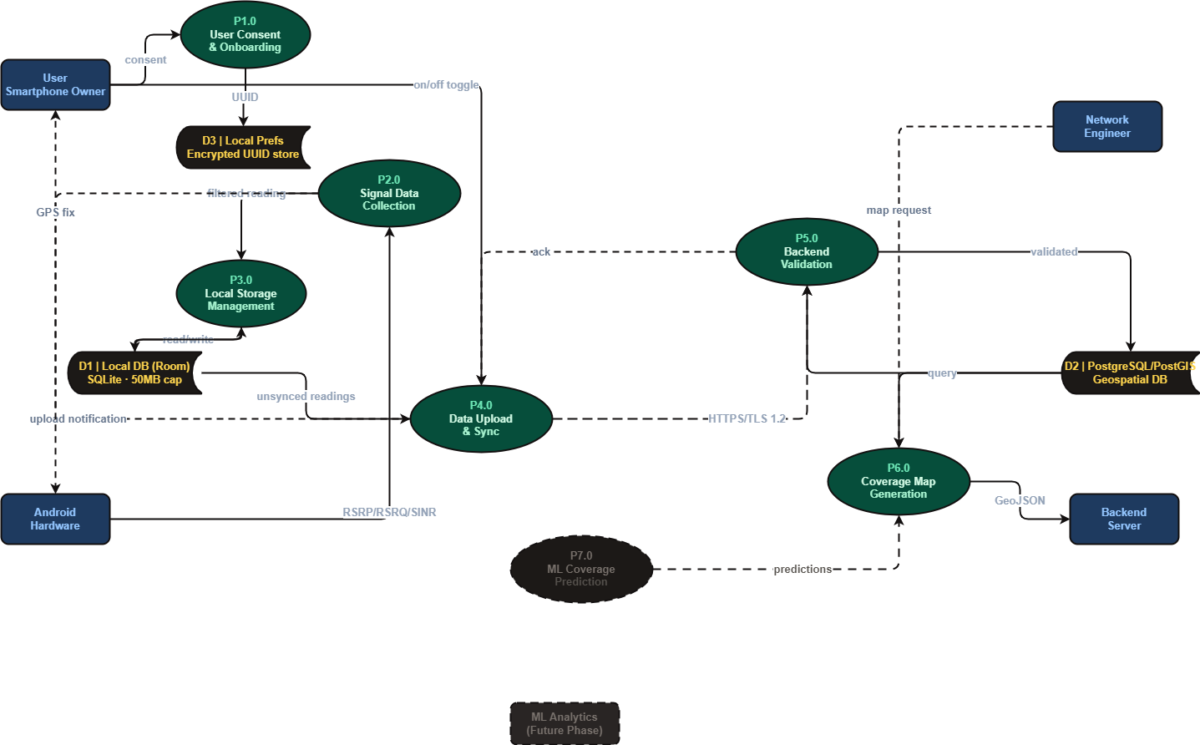
Data Flow Diagram (Level 1)
P5.0
P1.0
Backend Validation
User Consent & Onboarding
Generates UUID, stores in encrypted prefs
Cameroon bounding box, GPS deduplication, auth
P2.0
Signal Data Collection
Reads RSRP, RSRQ, SINR via TelephonyManager every 10s
P3.0
Local Storage Management
Room DB, 50MB cap, offline-first
P4.0
P6.0
Data Upload & Sync
Coverage Map Generation
HTTPS/TLS 1.2, WiFi default, 30min retry
PostGIS spatial query → GeoJSON heatmap

Slide 6
Use Case Diagram
Actors
Key Use Cases
User (Smartphone Owner)
Start / Stop Data Collection
Upload Data to Server ⟨includes Sync on Retry⟩
Primary contributor
View Live Signal Dashboard
Export Coverage Data (GeoJSON / CSV)
Network Engineer
Primary consumer (MTN/Orange)
View Coverage Heatmap
Grant Permissions (onboarding)
Android System Services
Configure Settings
Collect Signal Reading ⟨includes Provide GPS Fix, Anonymise & Store⟩
Non-human: TelephonyManager, GPS

Slide 7
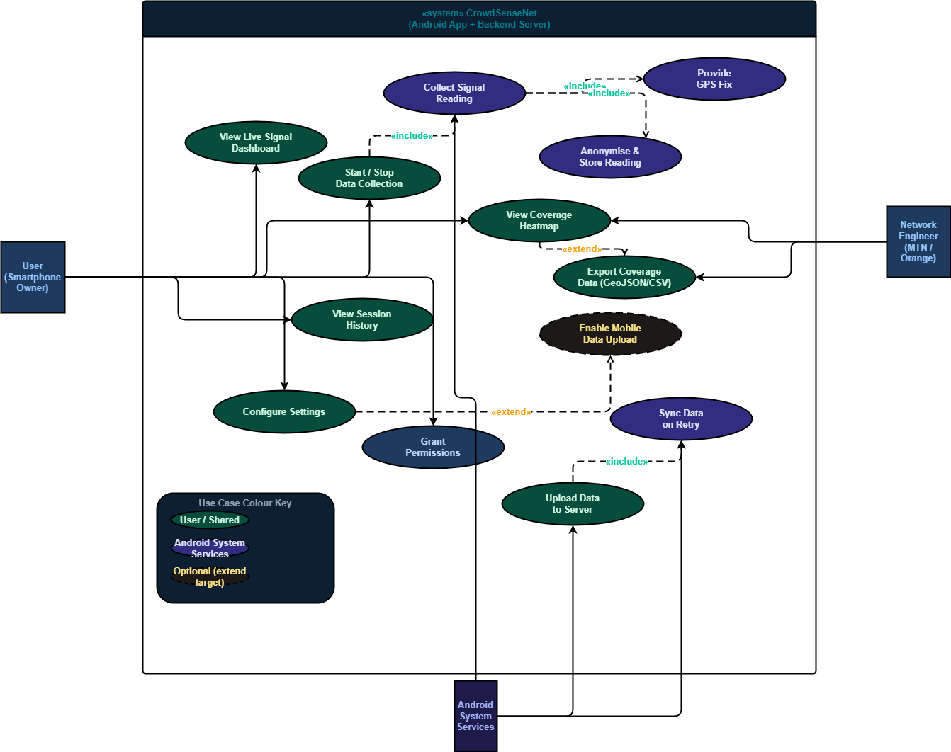
Use Case Diagram

Slide 8
Sequence Diagram .. Core Data Collection
Phase 1
App Launch & Consent
User opens app → consent screen → grants permissions → UUID generated → sensor loop activated
Phase 2
Data Collection Loop
Every 10s (while moving): read RSRP/RSRQ/SINR → GPS fix → accuracy check (≥15m discarded) → anonymise → write to Room DB → update UI
Phase 3
Upload (alt fragment)
WiFi available: batch upload via HTTPS/TLS 1.2 → backend validates → stores in PostGIS → marks as synced
No WiFi: queue locally, retry in 30 min
Phase 4
Coverage Map Serving
Map screen opened → query backend → PostGIS spatial query → GeoJSON heatmap returned → displayed in app

Slide 9
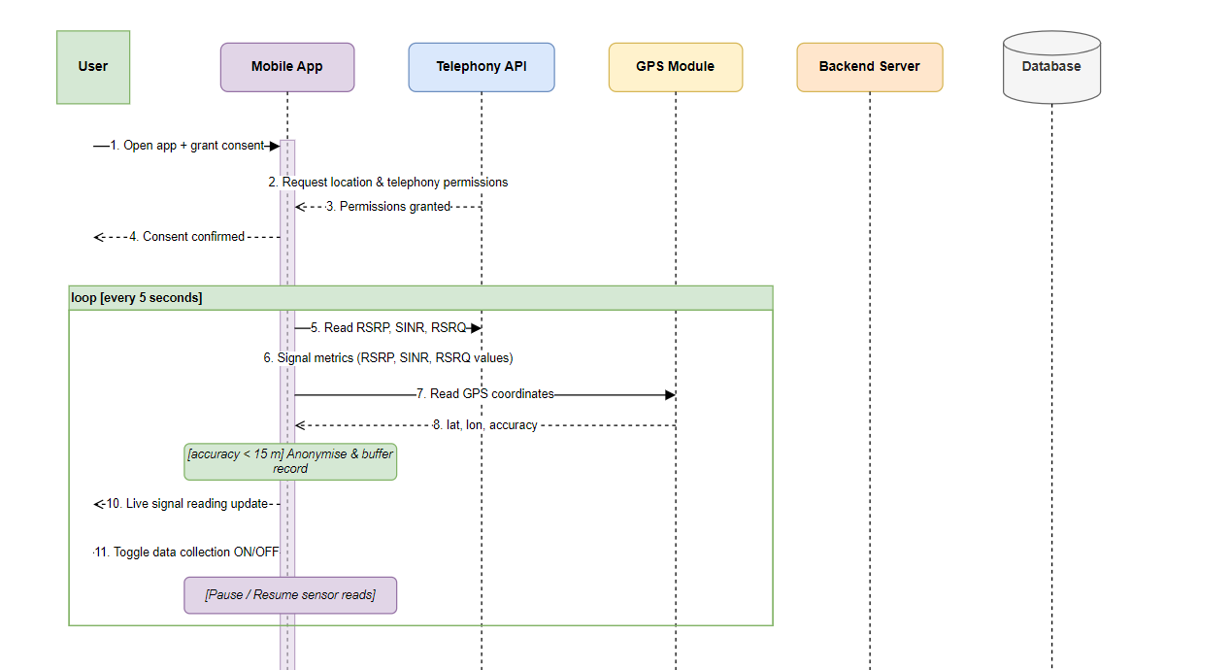
Sequence Diagram

Slide 10
Class Diagram MVVM Architecture
Presentation
ViewModel
HomeScreen, MapScreen, HistoryScreen, SettingsScreen, OnboardingScreen
HomeViewModel, MapViewModel, HistoryViewModel, SettingsViewModel
Domain / Service
SignalCollector, SyncManager, LocationManager, PermissionManager + 2 interfaces
Data
SignalReading, Session, User, MLPrediction, LocalDatabase
Enumerations
CoverageClass, NetworkType, CollectionMode
Network
BackendAPI, APIResponse, APIError
Repository
SignalRepository, SessionRepository, PredictionRepository

Slide 11
Key Classes & Relationships
SignalReading
Session
SignalCollector
id, deviceUUID, rsrp, rsrq, sinr, rssi,
cellId, lat, lon, timestamp, isSynced
sessionId, deviceUUID, startTime,
endTime, totalReadings, uploadStatus
implements DataCollector
startCollection(), stopCollection(),
pauseCollection(), resumeCollection()
SyncManager
BackendAPI
LocalDatabase
implements DataUploader
uploadData(), checkConnectivity(),
scheduleRetry()
uploadReadings(), fetchPredictions()
Handles auth tokens & error responses
dbInstance, storageUsedMB
maxStorageMB = 50MB
Room/SQLite auto-prune

Slide 12
Deployment Diagram Three-Tier Architecture
Tier 1 – Client
Tier 2 – Backend
Tier 3 – Analytics (Future)
Android Device
Backend Server
ML Analytics Server
• Kotlin UI (Home, Map, History, Settings)
• FastAPI REST API (auth, routing, export)
• Coverage Prediction Model
• WorkManager – background sync
• Data Validator (bounding box, dedup)
• Model Training Pipeline
• Adaptive Sampling Controller
• PostGIS Spatial Query Engine
• Heatmap Generator (→ GeoJSON)
• Room DB (SQLite, 50MB cap)
• PostgreSQL + PostGIS DB
External
Tier 1 – OS APIs
Google Maps Tile Service
• uuid.prefs + settings.prefs
Android System Services
• Base map tiles (HTTPS)
• TelephonyManager (RSRP, RSRQ, SINR)
• FusedLocationProvider (GPS + accuracy)

Slide 13
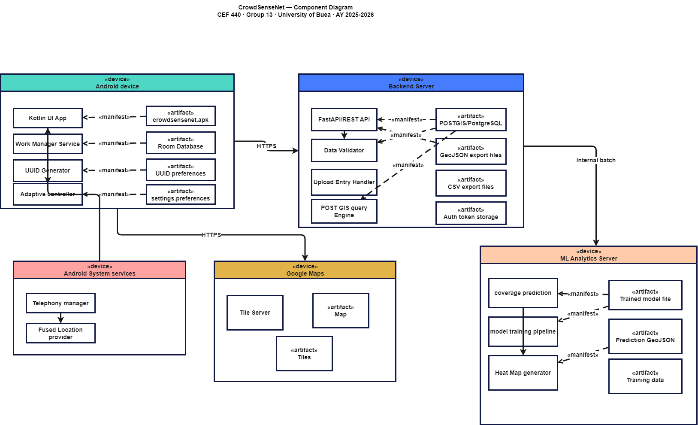
Deployment Diagram Three-Tier Architecture

Slide 14
Key Design Decisions & Evidence
Decision 1: 10s interval (moving) + pause when stationary
Rationale: Balances real-time data vs. battery (<5%/hr). Engineers: 5s minimum; 10s + adaptive pause meets both.
Decision 2: GPS accuracy threshold: 15 metres
Rationale: Set from network engineer interviews. Applied on-device before record is written to avoid corrupting coverage maps.
Decision 3: WiFi-only upload by default
Rationale: 56% of survey users required data-saving conditions. Alt fragment makes both paths explicitly testable.
Decision 4: On-device anonymisation before any data leaves
Rationale: Non-negotiable for 56/100 survey respondents. Backend never receives PII — not even in transit.
Decision 5: UUID generated on first launch, encrypted SharedPreferences
Rationale: Resolves conflict: full anonymity + device-consistent readings for ML model (Task 3, §2.1.3).

Slide 15
Conclusion
CrowdSenseNet …. A Complete Architectural Blueprint
✓ Context Diagram — system boundary confirmed, 4 stakeholder groups accounted for
✓ DFD Level 1 — 7 internal processes from consent to ML prediction
✓ Use Case Diagram — 12 functional interactions, include + extend relationships
✓ Sequence Diagram — 4-phase runtime model with combined fragments
✓ Class Diagram — 29 classes, 2 interfaces, 3 enums, 32 relationships (MVVM)
✓ Deployment Diagram — 5 nodes across 3-tier architecture
Every decision traceable to Task 3 SRS requirements and Task 2 stakeholder evidence.

